Slide 1
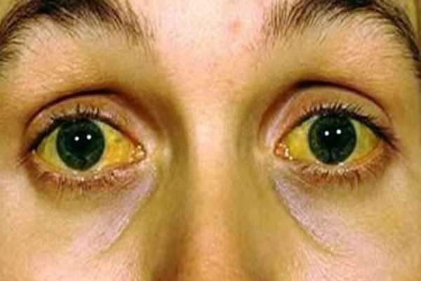
jaundice
Dr. Muntadher Abdulkareem Abdullah
M.B.Ch.B,CABM,FIBMS,FIBMS(GE.&HEP.)

Slide 2
Jaundice
yellow discoloration of the skin, conjunctivae, and mucous membranes, resulting from widespread tissue deposition of the pigmented metabolite bilirubin.
In adults, the normal bilirubin concentration is lower than 1 to 1.5 mg/dL.
Jaundice is usually detectable clinically when the plasma bilirubin exceeds 40 µmol/L (~2.5 mg/dL).
Yellowish discoloration of skin also can result from excessive deposition of carotene in hypercarotenemia, how differ from hyperbilirubinemia clinically ?
In a patient with jaundice it is useful to consider whether the cause might be pre-hepatic, hepatic or post-hepatic.

Slide 3
Pre-hepatic jaundice:
This is caused either by haemolysis or by congenital hyperbilirubinaemia, and is characterised by an isolated raised bilirubin level.
Usually mild , lemon colour , normal urine and stool .
In haemolysis, destruction of red blood cells or their marrow precursors causes increased bilirubin production. Jaundice due to haemolysis is usually mild because a healthy liver can excrete a bilirubin load six times greater than normal before unconjugated bilirubin accumulates in the plasma. This does not apply to newborns, who have less capacity to metabolism bilirubin.
The most common form of non-haemolytic hyperbilirubinaemia is Gilbert’s syndrome

Slide 4
Hepatocellular jaundice
Hepatocellular jaundice results from an inability of the liver to transport bilirubin into the bile, occurring as a consequence of parenchymal disease.
In hepatocellular jaundice, the concentrations of both unconjugated and conjugated bilirubin in the blood increase.
There is tea colour urine with normal colour stool

Slide 5
Characteristically, jaundice due to parenchymal liver disease is associated with increases in transaminases (AST, ALT), but increases in other LFTs, including cholestatic enzymes (GGT, ALP), may occur and suggest specific aetiologies .
Acute jaundice in the presence of an ALT of >1000 U/L is highly suggestive of an infectious cause (e.g. hepatitis A or B), drugs (e.g. paracetamol) or hepatic ischemia.
Imaging is essential, in particular to identify features suggestive of cirrhosis, define the patency of the hepatic vasculature and obtain evidence of portal hypertension.
Liver biopsy has an important role in defining the aetiology of hepatocellular jaundice and the extent of liver injury

Slide 6
Obstructive (cholestatic) jaundice
Cholestatic jaundice may be caused by:
• failure of hepatocytes to initiate bile flow
• obstruction of the bile ducts or portal tracts
• obstruction of bile flow in the extrahepatic bile ducts between the porta hepatis and the papilla of Vater

Slide 7
Clinical features and complications of cholestatic jaundice
Cholestasis Early features: • Jaundice • Dark urine • Pale stools • Pruritus
Late features: • Malabsorption (vitamins A, D, E and K): weight loss, Steatorrhoea, Osteomalacia, bleeding tendency • Xanthelasma and xanthomas
Cholangitis • Fever • Rigors

Slide 9
Key history points in patients with jaundice:
Symptoms* • Itching preceding jaundice
• Abdominal pain (suggests stones)
• Weight loss (chronic liver disease and malignancy)
• Dark urine and pale stools •
Fever ± rigors • Dry eyes/dry mouth • Fatigue Recent drug history
Other:
Exposure to intravenous drug or blood transfusions
• Travel history and country of birth
• Metabolic syndrome (increased body mass index ± type 2 diabetes/ hypertension)
• Autoimmune disease history
• Alcohol history • Inflammatory bowel disease
• Family history of liver disease, autoimmune disease or the metabolic syndrome

Slide 10
Approach to patient with jaundice
History
Physical examination
Investigation :

Slide 12
THANKS

